Slide 1
Deep Learning & AI
Assignment 3
team # 4
Wenjun song
Haimin zhang
Yanjun lyu

Slide 2
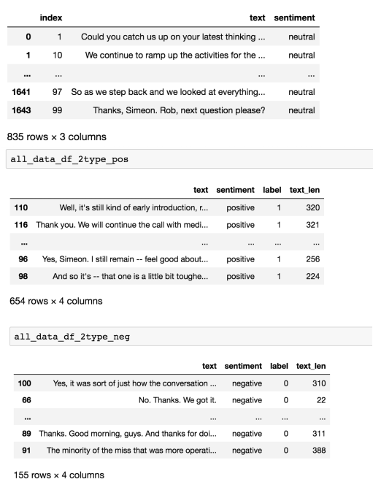
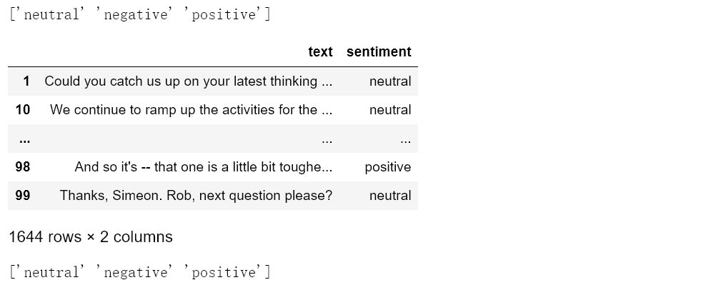
1. Merge tha dataset
Combine 12 teams datasets
Correct the errors of 12 json files
sentiment | number | Percent
Neutral | 835 | 0.507907542
Positive | 654 | 0.397810218
Negative | 155 | 0.094282238

Slide 3


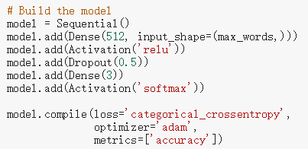
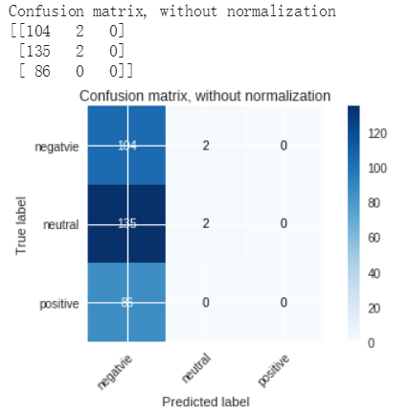
2. Experiment
BOW model:

Slide 4
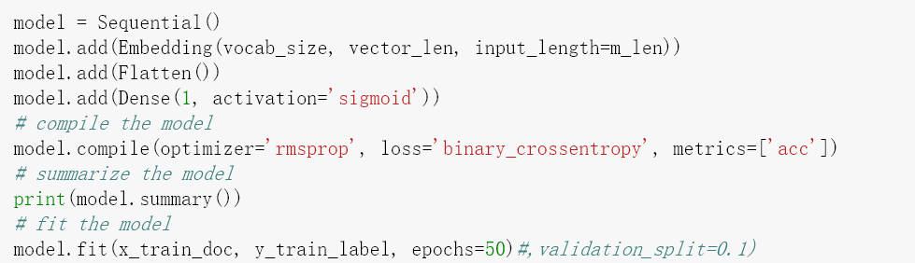
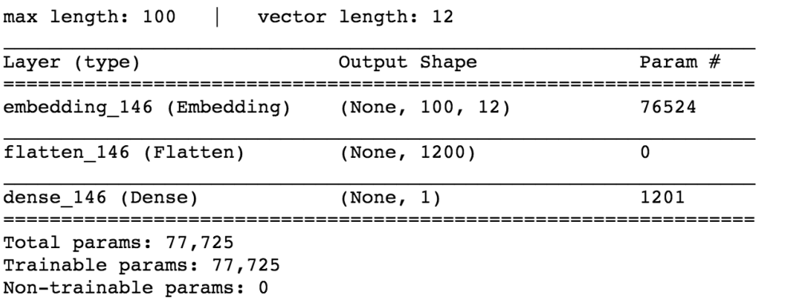
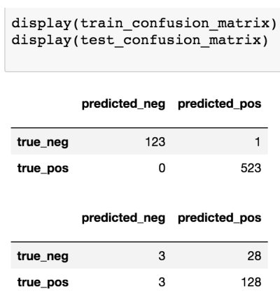
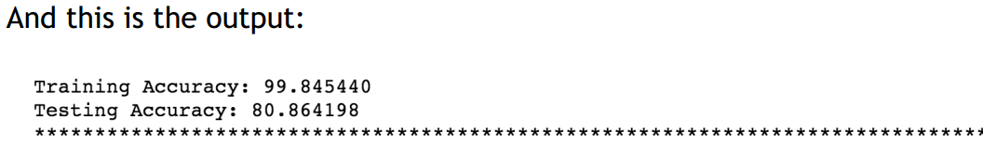
2. Experiment
GLOVE model:

Slide 5
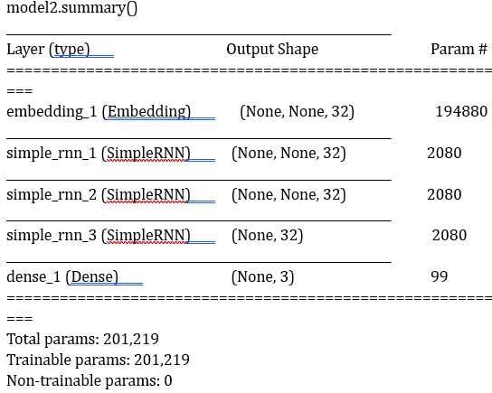
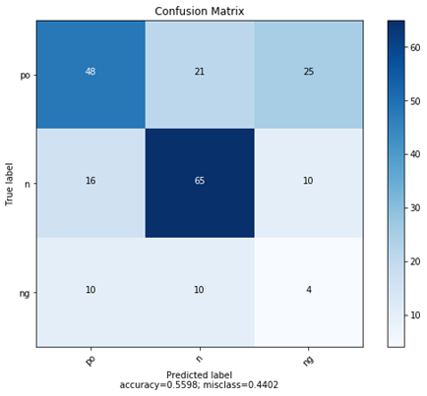
2. Experiment 1
RNN Model:

Slide 6
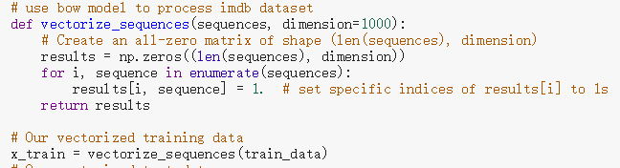

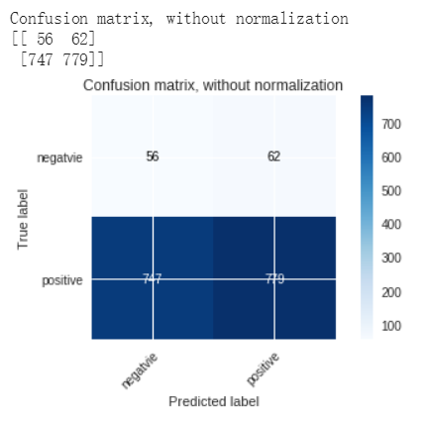
3. Experiment 2
BOW model:
training accuracy：0.9724

Slide 7
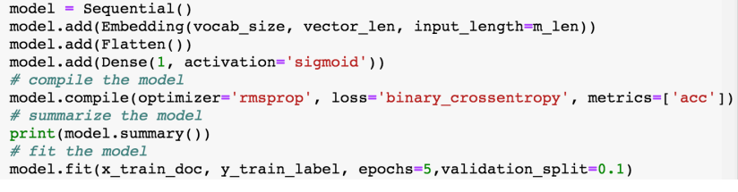
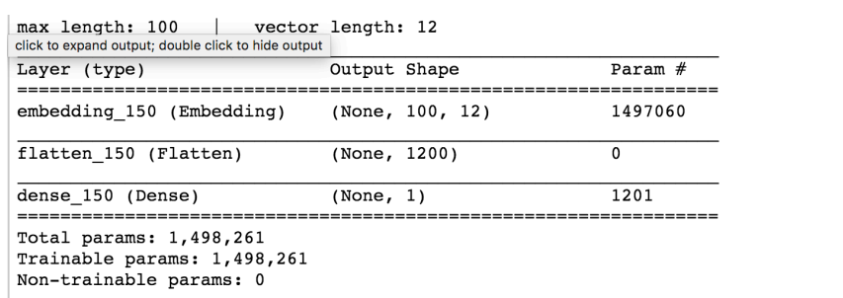
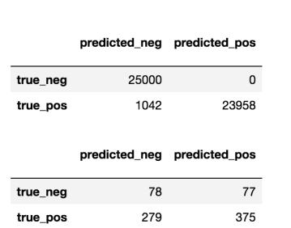
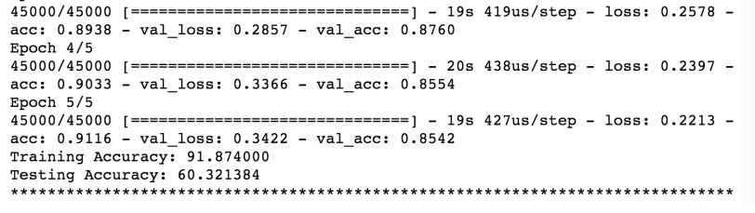
3. Experiment 2
GLOVE model:

Slide 8
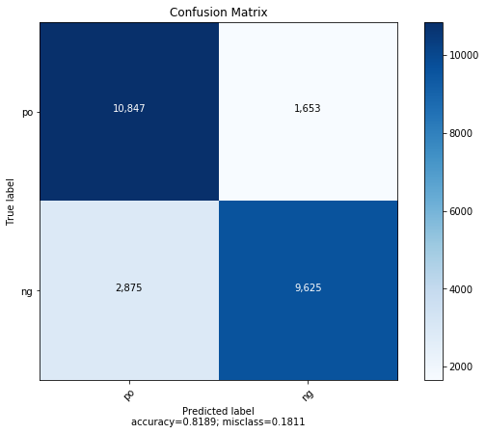
3. Experiment 2
RNN model:
The accuracy come to 0.8189 for test set.
The confusion matrix as below:

Slide 9
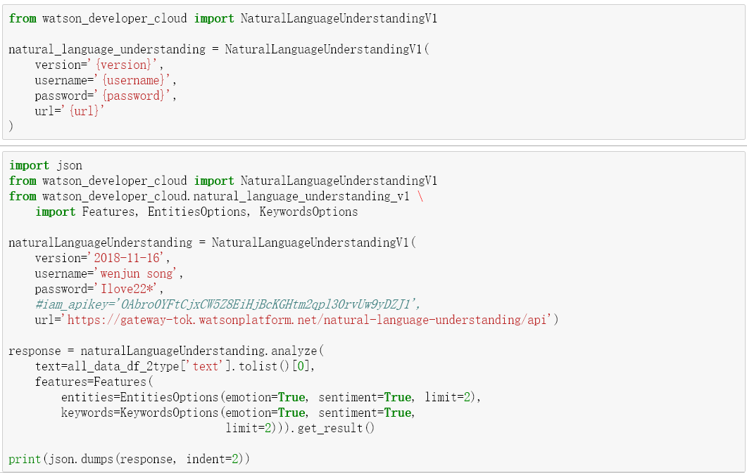
4. Experiment 3
IBM API:
NOT finished

Slide 10
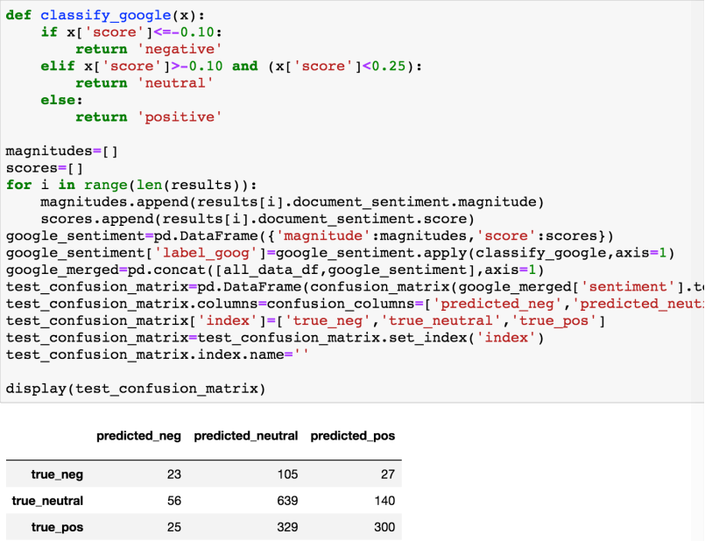
4. Experiment 3
Google API:
accuracy is 58.51

Slide 11
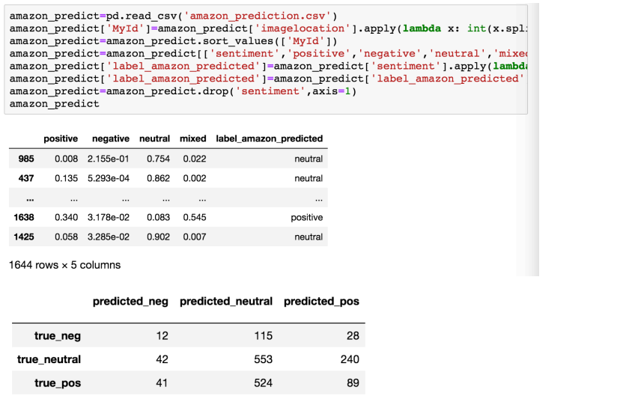
4. Experiment 3
Amazon API:
accuracy is 39.78.

Slide 12
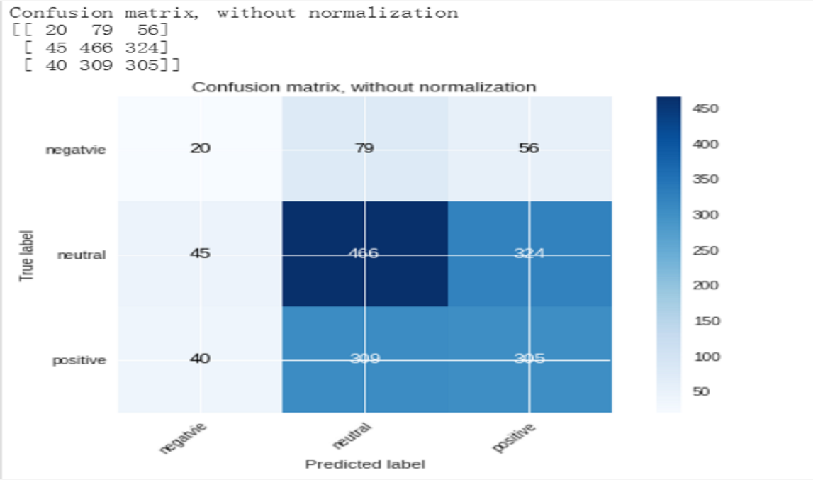
4. Experiment 3
Microsoft API:
accuracy is 48.11.
From the models—
BOW, GLOVE, RNN, GOOGLE-API, AMAZON-API, MICROSOFT-API
THE Google API is the best model so far.

Slide 13
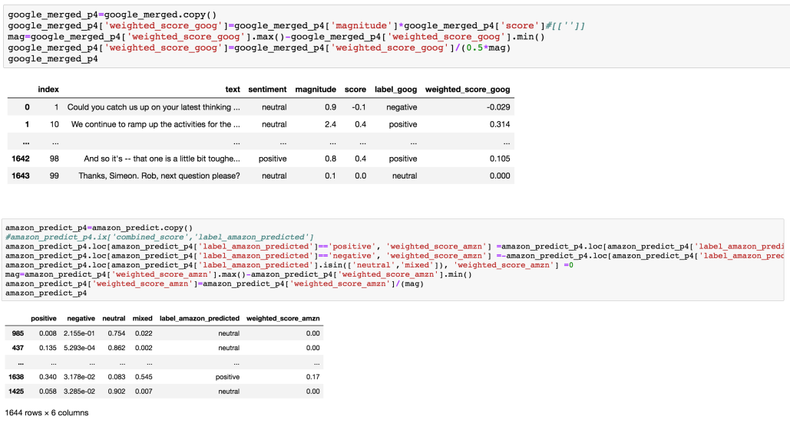
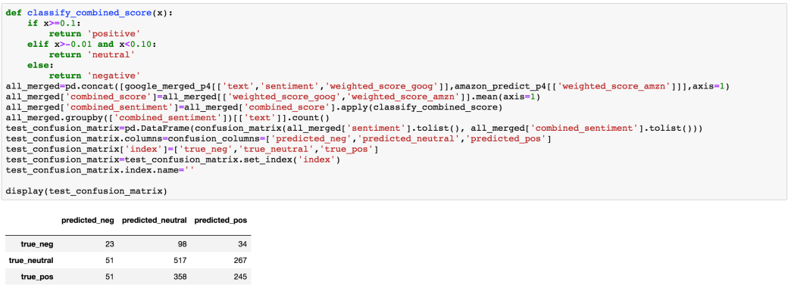
5. Experiment 4
Merge Google, Amazon, Microsoft API:
accuracy is 47.99. better than Amazon, less than Google
From the models—

Slide 14
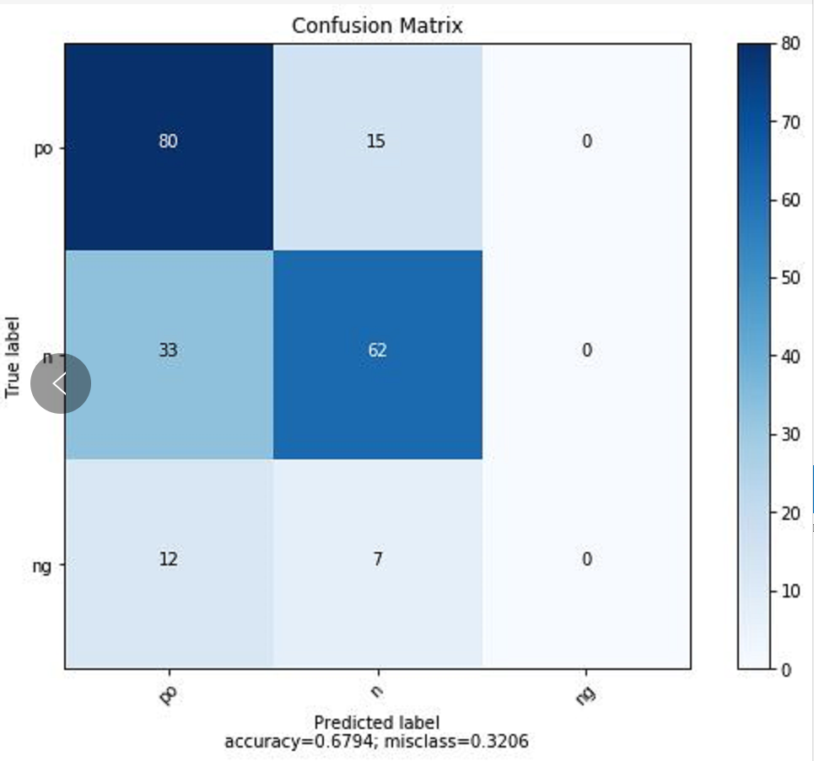
5. Experiment 4
TPOT, Auto-sklearn, H20.AI models:
TPOP model:

Slide 15
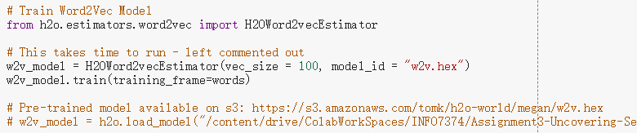
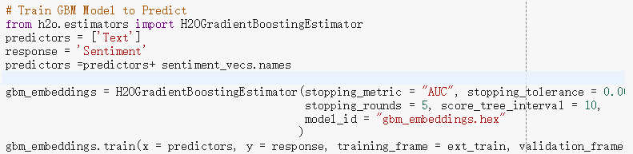
5. Experiment 4
TPOT, Auto-sklearn, H20.AI models:
H20.AI models :
1.use word2vec model to train the text
2. train GBM Model to Predict

Slide 16
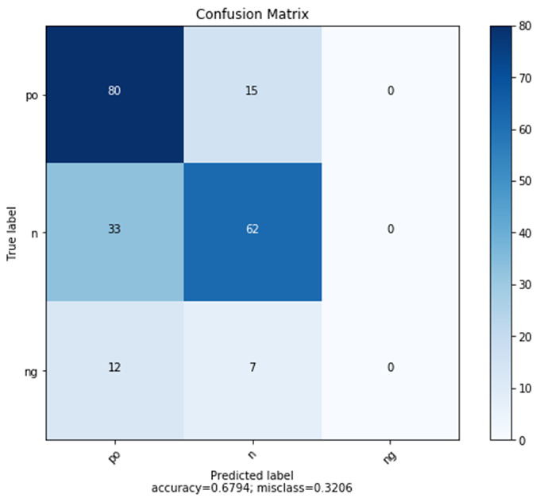
TPOT
TPOT is a Python Automated Machine Learning tool that optimizes machine learning pipelines using genetic programming
TPOT gives a model with score 0.6650717703349283

Slide 17
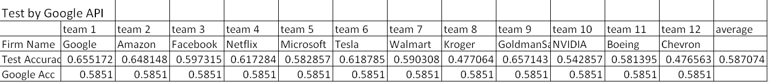
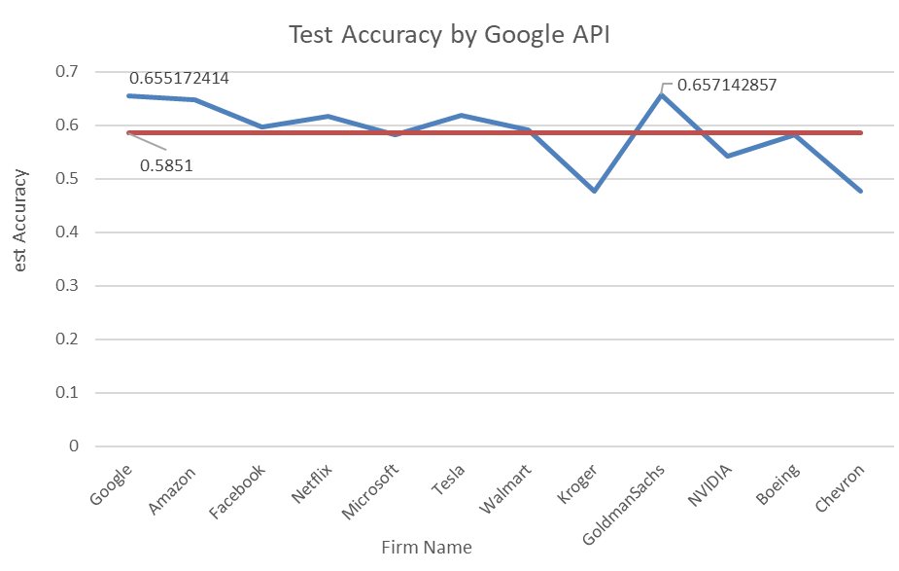
6. Test
Choose Google API to test 12 teams files:

Slide 18
7. Conclusion
Three kinds models:
BOW, GLOVE, RNN
Not BAD.
Applying to more data – movie dataset, lower accuracy (make sense)
2. Google, Amazon, Microsoft API
Much difference among them.
Complex to use these platforms.
Google is the best
3. TPOT, Auto-sklearn, H2O.ai

